Slide 1




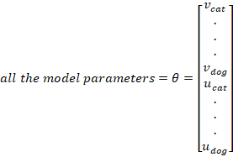




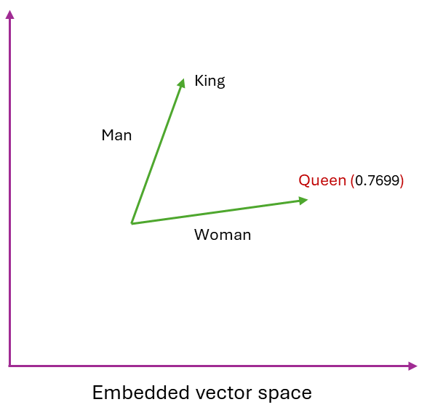
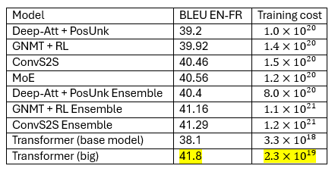

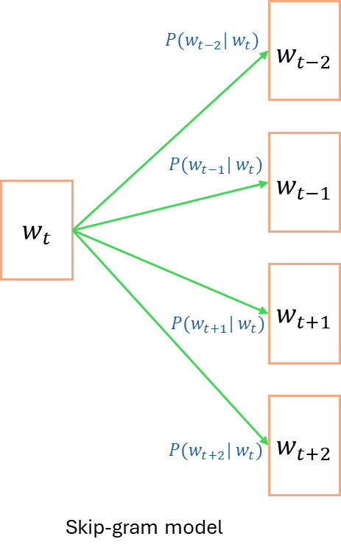
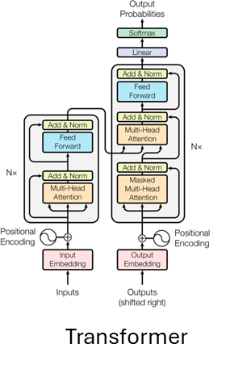
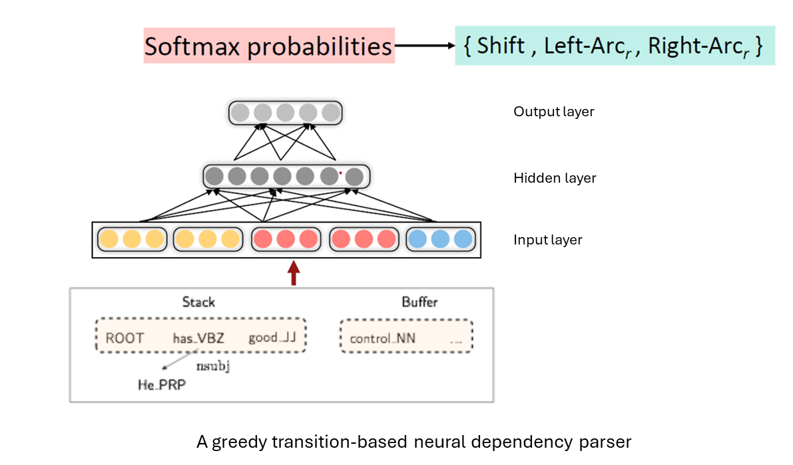
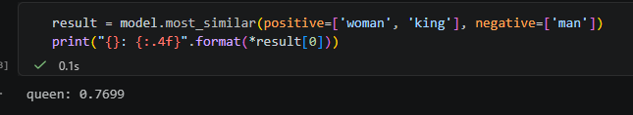
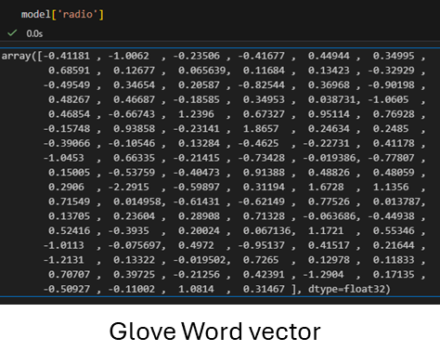
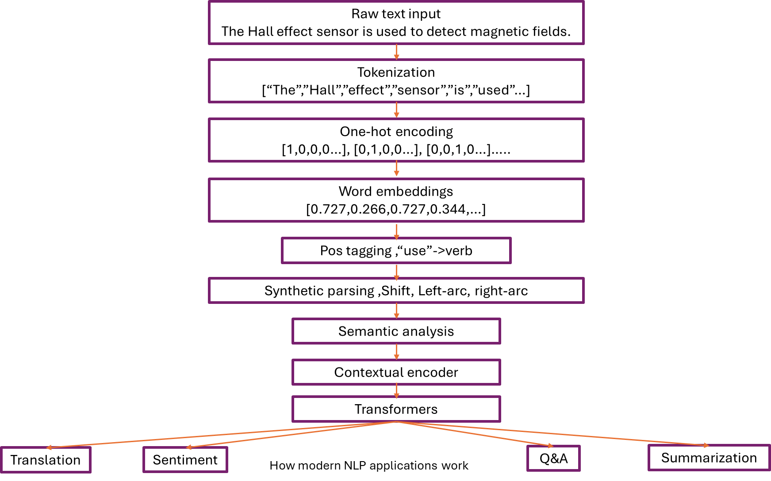
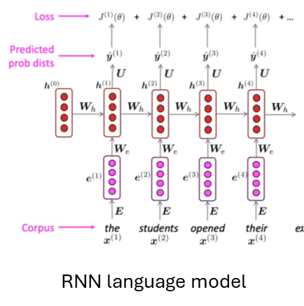
Natural Language Processing(NLP)
Your Full Name and My Full Name (54)
Ramu Battu and Nitaigour P Mahalik
Department of Industrial Technology, Jordan College of Agricultural Science and Technology, California State University, Fresno, California, USA
Abstract
METHODOLOGY
RESULTS
Natural Language Processing(NLP) is a field that studies the development of automatic systems that allow machines to understand and generate human languages. NLP has applications in different fields such as information extraction, question answering systems, machine translation, automatic summarization and spam detection . In this poster, an overview of NLP is presented by focusing on the skip-gram model. Besides, this study introduces other related concepts, including Co-occurrence matrix, Global vectors for word representation (Glove),a greedy transition based neural dependency parser ,n gram language model and attention-based architectures in brief.
Skip-gram model
Evaluating word vectors refers to quantitatively measuring the quality of word embeddings. There are two main approaches to evaluate word vectors, including intrinsic evaluation and extrinsic evaluation. In intrinsic evaluation, specific subtasks are used for the evaluation. Conversely, in extrinsic evaluation, a set of word vectors is evaluated on the real task at hand. In Language models, perplexity is used for evaluating models. Moreover, it is a measure of uncertainty when predicting the next word based on a word sequence, where lower values depict higher confidence in predicting. BLEU(Bilingual Evaluation Understudy) score and GLUE(General Language Understanding Evaluation) score are two extrinsic methods that are used for evaluating NLP models. In BLEU, each word in the output sentence is assigned a score of one if it is in the ground truth. Unless they are assigned 0, and subsequently the count is divided by the number of words in the output for the normalization. GLUE contains nine different task data sets for evaluating performance and understanding of the model, and the final score is based on the score for these nine diverse tasks.
The probability will become larger when the dot product increases.
INTRODUCTION AND BACKGROUND
position in the corpus
Natural Language Processing (NLP) is a filed that concentrates on developing computational techniques for representation, analyzing and generating human languages. Mainly, NLP can be broken into two parts including Natural Language Understanding (NLU) and Natural Language Generation(NLG). Human language is complex due to several reasons, such as context dependence and the attachment of ambiguity. Moreover, the meaning of a word in a text usually depends on its surrounding words and grammatical structure. This makes it difficult to model them. Moreover, the distribution of words surrounding a particular word illustrates the meaning of that word. For instance, if we pick up “tea” from a sentence, the distribution of surrounding words may consist of kettle, hot, delicious, pot, drink, etc., and similar words to “tea” (like “coffee”) can have a similar distribution. The major problem in natural language processing was the representation of words in computer systems such that preserves semantic similarity and relationships between words. For addressing this problem, representing words as vectors in higher dimensional space is introduced. More recently, NLP has evolved rapidly with introduction of attention and transformer archiectures.
Converting it to a summation, changing the sign to achieve minimization, Minimizing the objective function allows for maximizing predictive accuracy
Taking partial derivatives,
Model | Dev | Test | ACE | MUC7
One-hot/count-based | 91.0 | 85.4 | 77.4 | 73.4
SVD (Singular Value Decomposition) | 90.8 | 85.7 | 77.3 | 73.7
SVD-S | 91.0 | 85.5 | 77.6 | 74.3
SVD-L | 90.5 | 84.8 | 73.6 | 71.5
CBOW (Word2Vec) | 93.1 | 88.2 | 82.2 | 81.1
GloVe | 93.2 | 88.3 | 82.9 | 82.2
Model | WS353 | MC | RG | SCWS | RW
SVD (Singular Value Decomposition) | 35.5 | 35.1 | 42.5 | 38.3 | 25.6
SVD-S | 56.5 | 71.5 | 71.0 | 53.6 | 34.7
SVD-L | 65.7 | 72.7 | 75.1 | 56.5 | 37.0
CBOW (Word2Vec) | 57.2 | 65.6 | 68.2 | 57.0 | 32.5
SkipGram (Word2Vec) | 62.8 | 65.2 | 69.7 | 58.1 | 37.2
GloVe | 65.8 | 72.7 | 77.8 | 53.9 | 38.1
Method | Perplexity
Interpolated kneser-Ney 5-gram -2013 | 67.6
RNN-1024 + MaxEnt 9-gram – 2013 | 51.3
RNN-2048 + Blackout sampling -2015 | 68.3
Sparse Nong-negative matrix factorization -2015 | 52.9
LSTM-2048 -2016 | 43.7
2-layer LSTM-8192 – 2016 | 30
Ours small (LSTM-2048) | 43.9
Ours large (2-layer LSTM-2048) | 39.8
Using chain rule,
Gradient descents,
Skim-gram model with negative sampling
Parser | UAS (Unlabeled attachment score) | LAS (Labeled attachment score) | Sent./s
MaltParser | 89.8 | 87.2 | 469
MSTParser | 91.4 | 88.1 | 10
TurboParser | 92.3 | 89.6 | 8
Chen &Manning 2014 | 92.0 | 89.7 | 654
LITERATURE REVIEW
Attention
Natural language processing has developed over several decades. The basic idea of natural language processing came from a statement of Firth (1957), “You shall know a word by the company it keeps”. In the earliest approaches, words are represented as one-hot vectors. In one-hot vectors, only one element is 1, and all other elements are zero. In this approach main problem was no way to represent similarity between words. In the next stage, co-occurrence matrices were introduced. In co-occurrence matrices each word is represented by the frequency of surrounding words. Moreover, it involves with defining a vocabulary, choosing a series of documents, and counting the co-occurrence and normalizing the matrix by getting the row sum. A window is used for limiting distribution, and afterward, the log token frequency method is introduced to avoid emphasizing common words like “the”. Although this approach considers the context of the text for capturing semantic similarity between words, there were some problems associated with this method, including high dimensionality. For addressing the issue of high dimensionality, a singular value decomposition-based method called Latent Semantic Analysis can be used. In 2013, Word2vec method was introduced for overcoming these difficulties. In Word2vec approach, the main idea is that words that are used in a similar context can have similar meanings. Furthermore, word2vec contains two main models, including Skip gram model and Continuous Bag of Words (CBOW) model. In the Continuous Bag of Words model, predicting the center word based on surrounding words within a window is used. Conversely, in Skip-gram model, predicting surrounding words within a window is used when the center word is given. In other words, this algorithm learns word vectors and maps word vectors into space by preserving semantic similarity and meaningful relationships. Moreover, it uses a probabilistic softmax model to make predictions. In addition to softmax (Naïve softmax), hierarchical softmax and negative sampling can be used for training and optimization. Negative sampling trains the model using binary logistic regression to separate real word pairs from random ones.
Global vectors for word representation (Glove) is another method, which is used in Natural Language Processing. Glove uses global statistics to learn word representations by predicting the likelihood of a particular word appearing in the context of another word based on a least squares objective. Basically, this method focuses only on non-zero elements of the word-word co-occurrence matrix to avoid unnecessary computations. Moreover, Glove model is based on the idea of log bilinear model. In it, word relations can be captured via getting the vector difference in embedded space.Parser trees are used for analyzing the syntactic structure of sentences. Basically, there are two types: constituency structures and dependency structures. Dependency structures in which words depend on other words. A greedy transition-based neural dependency parser is a type of dependency parser that has better performance and better efficiency than traditional models. It consists of an input layer, a hidden layer with ReLu function, and a softmax layer with a cross-entropy loss function. The cross-entropy function measures the difference between true probability and predicted probability.
Language models are systems that can predict what word will come next. In other words, when a sequence of words is given, the language model can compute the probability distribution of the next word. n-gram language model is one type of language model. In it, the main idea is gathering statistics about the frequency of different n-grams and predicting the next word based on it. Fixed-window Neural language models is another type of language model. Furthermore, Recurrent neural networks (RNNs), long short-term memory RNNs (LSTMs), and Transformers are methods that are used to create language models. In today's world, transformers based on attention have become more dominant in all natural language processing tasks.
DESIGNS
King- man+ woman = queen (GloVe)
DISCUSSION AND CONCLUSIONS
Although Natural Language Processing techniques have evolved rapidly over this decade, some limitations, such as long-range reasoning, domain adaptation, and interpretability, still remain. Challenges like developing NLU models that can understand expressions, cultural dialects, informal phrases, and idioms can be accomplished at least to a certain extent by training based on a huge data set and updating it regularly. But, dealing with words that have different meanings in different geographical areas is still hard to accomplish. Traditionally, NLP models follow the Markov assumption, which states that a word depends only on a limited range of preceding words to avoid high computational cost. That limits capturing long-range dependencies. Transformers have overcome this limitation using the attention technique. According to graphs, GloVe model has performed as the most accurate word embedding method for all tasks and co-occurrence evaluation. The greedy transition-based neural dependency parser illustrates a good balance between speed and accuracy. Furthermore, LSTM based language models has performed well over N-gram models and RNN based language models. In machine translation evaluation, transformer-based models have demonstrated high accuracy and low training cost at the same time. Overall, the transformer and attention-based architectures have dominated many sub-sectors under the umbrella of NLP by representing contextual relations and modeling long-range relationships.
REFERENCES
1. Khurana, D., Koli, A., Khatter, K., & Singh, S. (2022). Natural language processing: state of the art, current trends and challenges. Multimedia Tools and Applications, 82(3), 3713–3744. https://doi.org/10.1007/s11042-022-13428-4
2. Jain, A., Kulkarni, G., & Shah, V. (2018). Natural language processing. International Journal of Computer Sciences and Engineering, 6(1), 161–167. https://doi.org/10.26438/ijcse/v6i1.161167
3. Gangal, A., Shrivastava, A., Hussien, N. M., Singh, P., Diwakar, M., Joshi, K., Bisht, S., & Joshi, N. C. (2023). Natural language processing: A review. AIP Conference Proceedings, 2849, 020010. https://doi.org/10.1063/5.0153960
4. Stanford CS 224N | Natural Language Processing with Deep Learning. (n.d.). https://web.stanford.edu/class/archive/cs/cs224n/cs224n.1246/
5. Pennington, J., Socher, R., Manning, C. D., & Computer Science Department, Stanford University. (n.d.). GLOVE: Global Vectors for Word Representation. In Computer Science Department, Stanford University. https://nlp.stanford.edu/pubs/glove.pdf
6. Mikolov, T., Sutskever, I., Chen, K., Corrado, G., & Dean, J. (2013). Distributed Representations of Words and Phrases and their Compositionality. arXiv (Cornell University), 26, 3111–3119. https://doi.org/10.48550/arxiv.1310.4546
7. Wolf, T., Debut, L., Sanh, V., Chaumond, J., Delangue, C., Moi, A., Cistac, P., Rault, T., Louf, R., Funtowicz, M., Davison, J., Shleifer, S., Patrick, V. P., Ma, C., Jernite, Y., Plu, J., Xu, C., Scao, T. L., Gugger, S., . . . Rush, A. M. (2019). HuggingFace’s Transformers: State-of-the-art natural language processing. arXiv (Cornell University). https://doi.org/10.48550/arxiv.1910.03771
8. Chen, D., & Manning, C. (2014). A Fast and Accurate Dependency Parser using Neural Networks. A Fast and Accurate Dependency Parser Using Neural Networks, 740–750. https://doi.org/10.3115/v1/d14-1082
9. Miller, G. A. (1995). WordNet. Communications of the ACM, 38(11), 39–41. https://doi.org/10.1145/219717.219748
10. Rong, X. (2014). word2vec Parameter Learning Explained. arXiv (Cornell University). https://doi.org/10.48550/arxiv.1411.2738
11. Joulin, A., Grave, E., & Chiu, J. (2019, January 14). Building an efficient neural language model over a billion words. Engineering at Meta. https://engineering.fb.com/2016/10/25/ml-applications/building-an-efficient-neural-language-model-over-a-billion-words/
12. Liang, Y., University of Wisconsin-Madison, Dan Jurafsky, Dan Klein, Chris Manning, & Vaswani et al. (2021). CS 540 Introduction to Artificial Intelligence (By Fred Sala). https://pages.cs.wisc.edu/~yliang/cs540_1_fall21/documents/CS540-NLP.pdf
Notes:
1

